Slide 1
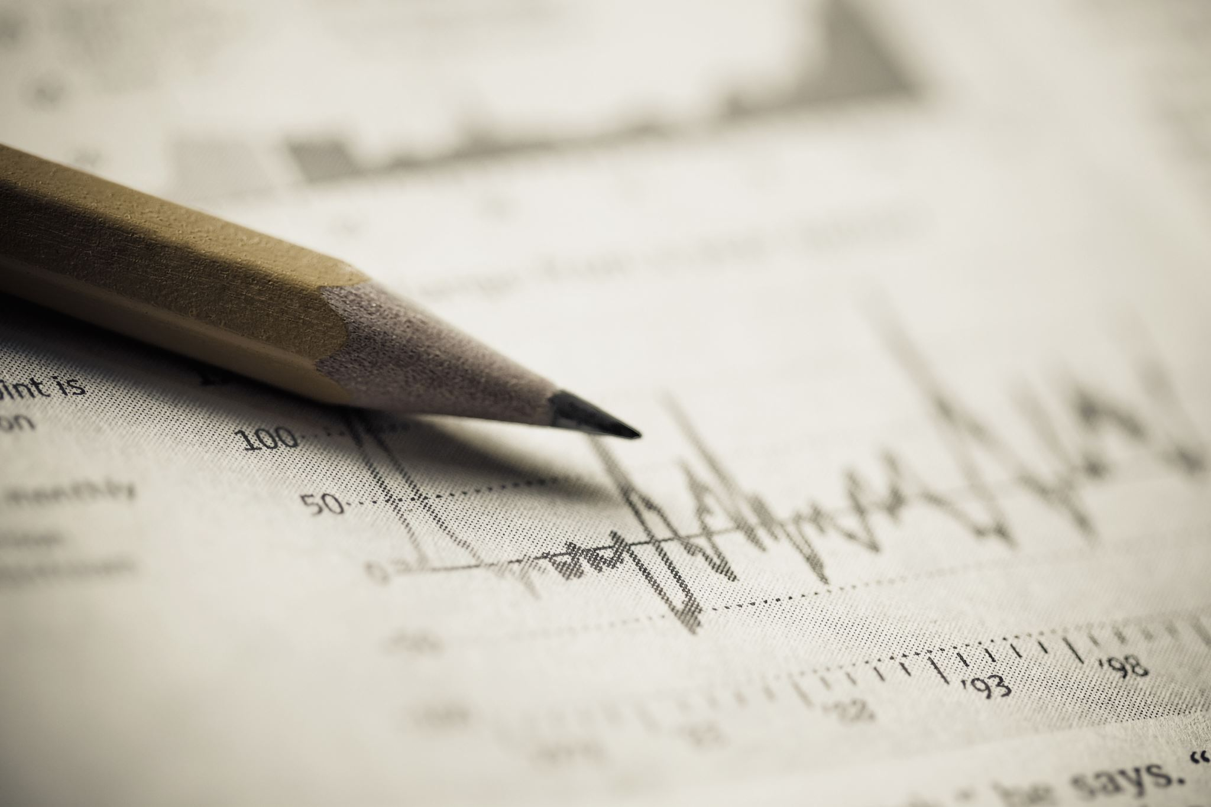

ChequeChecker – Handwritten Text Recognition
- John Jim Evans Veernapati
Notes:
Hello Everyone, I am John Jim Evans Veernapati. This video gives a brief description of my Capstone project. We know the present world is digitalizing, but we still have few areas which use traditional methods. One such areas is the banking industry where transactions using Cheques are predominant. We still use cheques to either credit or debit. Since this paper-based form of transfer is prone to manual errors, and if these errors are more the result that is the cost of these manual errors might be huge. So, I have decided to use Machine Learning to build an application that can help avoid the manual errors. As of now, I could not think of any better name for my project, So I temporarily named it as ChequeChecker.

Slide 2
Project Overview
Objective
Build an application which can scan the cheques, analyze the handwritten text and identify the amount that has to be credited or debited
Why is this Chosen?
A banking problem: Banks deal with several cheques, and there is high probability of manual errors
An application which can help all the banks
Notes:
The goal of my project is to build an application which can scan the handwritten text on a cheque and identify this text.
Why I chose this project?
As I told earlier, the cost of manual errors would be huge. So this application can play a significant role in reducing the manual errors. This application can also be used by a number of banks.

Slide 3
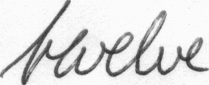
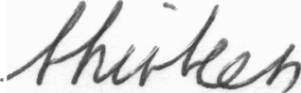
Data Source
IAM Handwritten Text Database 3.0
657 writers contributed samples of their handwriting
115'320 isolated and labeled words
Approximately 1 GB
Pictures of the words
Sample Data
Link
http://www.fki.inf.unibe.ch/databases/iam-handwriting-database/iam-handwriting-database#icdar02
Notes:
For the data source, I have looked for hand written database and found this data source interesting. IAM Handwritten Text Database has over 1 lakh words labelled and are contributed by 657 writers. The words are extracted from scanned written texts and are manually labeled. These words are stored in the form of pictures. The size of the data is approximately 1 GB. Here are the examples of the pictures of the words. The link to the data source is down below. We have to register on the site to access the data. I will also add the link to data source in the description section of this video.

Slide 4
Implementation Methodology: (Tentative)
Clean and process the words data
Link the word pictures with the labeling
Try Neural Networks to find the map between words
CNN, RNN, LSTM Networks
Identify the words from the cheque that has to be predicted using OpenCV/Google Tesseract
Pick the best network and predict the identified words
Visualize the results on a webapp
Tech Stack
Python – Machine Learning Algorithms
Flask – Web Application
Notes:
Here is the implementation methodology that I am looking at. Note that this is the temporary. Any ideas would be highly appreciated. In brief I would have to build the network using Neural networks. It can be any of CNN/RNN/LSTM Networks. After building the network, I will identify the words on the cheque using OpenCV and Google Teserract! As I am planning to build an application, it would be a web application where I would try to visualize the results.
For the Tech Stack, for machine learning - I would be using python and for the application development I would want to use flask.

Slide 5
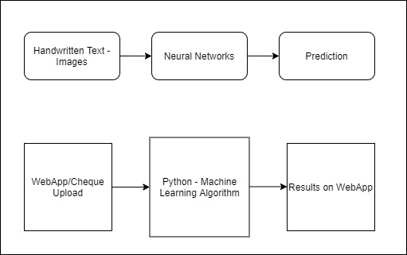
Low Level Architecture
Notes:
This slide shows the low level architecture of my project. Handwritten text images are processed and neural network is built on these images. Prediction is done on the handwritten words that are extracted from the cheques.
Webapplication would have an option to upload the cheque and the machine learning algorithm runs on the image and the results are displayed on the webapp.

Slide 6

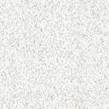
Thank you
Questions and Feedback?
jimevans.v@umbc.edu
https://github.com/jimevansv/Data_606

